Slide 1

LIBRARY MANAGEMENT
SYSTEM
VEMULA HIMAJA BACKEND DEVELOPER

Slide 2

INTODUCTION :
A Library Management System is software used to manage library operations digitally.
It maintains records of books, members, and transactions.
It helps in issuing and returning books efficiently.
It reduces manual work and minimizes errors.
It provides quick access to book availability and details.
It improves overall efficiency and saves time for librarians.
It helps in generating reports and tracking library activities easily.

Slide 3
OBJECTIVES :
To automate all library operations and reduce manual work
To maintain accurate records of books and members
To simplify the process of issuing and returning books
To provide quick and easy access to book information
To track availability of books in real-time
To reduce errors and improve data accuracy
To generate reports for better management and analysis

Slide 4
TECHNOLOGIES USED :
SAP ABAP – Used for developing reports and application logic
SAP Data Dictionary (SE11) – For creating database tables
Internal Tables & Work Areas – For data processing in ABAP
ALV (ABAP List Viewer) – To display output in table format
Module Pool Programming – For creating screens .
Open SQL – For database operations (SELECT, INSERT, UPDATE)
Smart Forms .

Slide 5
DATABASE TABLES:
The Database is designed using sap abap dictionary
The Transaction code is SE11
Starts with Z or Y
Tables Generated as given :
TABLES: DESC:
ZBOOK_MASTER – BOOK DETAILS
ZMEMBER -- MEMBER DETAILS
ZLIBRARY -- LIBRARIAN DETAILS
ZLIBRARY1 -- COPIES
ZTRANSACTION -- TRANSACTIONS

Slide 6
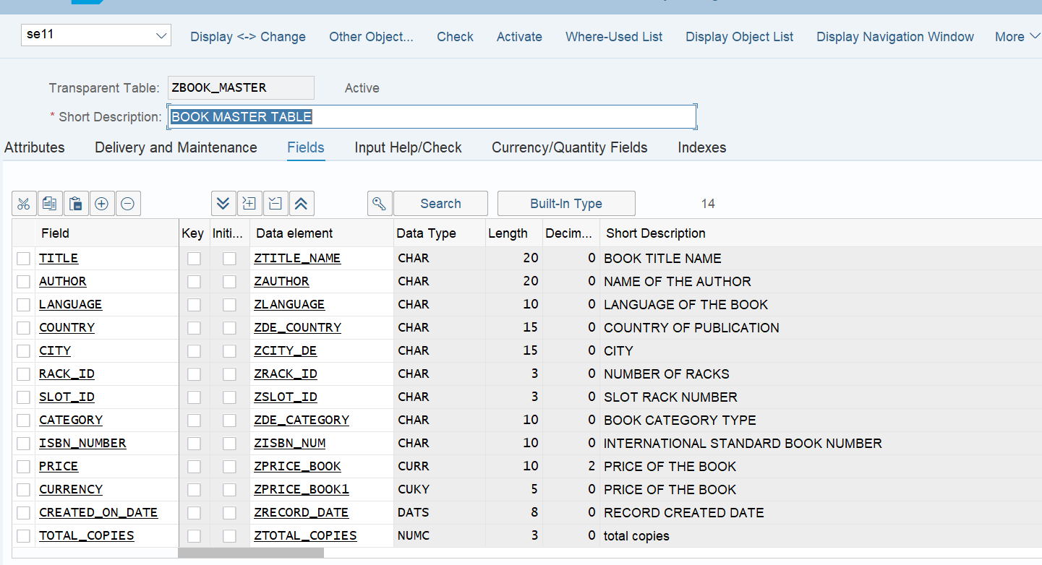
ZBOOK_MASTER – BOOK DETAILS
Stores complete information of all books in the library:
✅ Maintains details like book title, author, language, and category
✅ Includes publication details such as country and city
✅ Tracks book location using rack ID and slot ID
✅ Stores unique ISBN number for each book
✅ Maintains price and currency of the book
✅ Records total number of copies available
✅ Keeps track of record creation date 📚

Slide 7
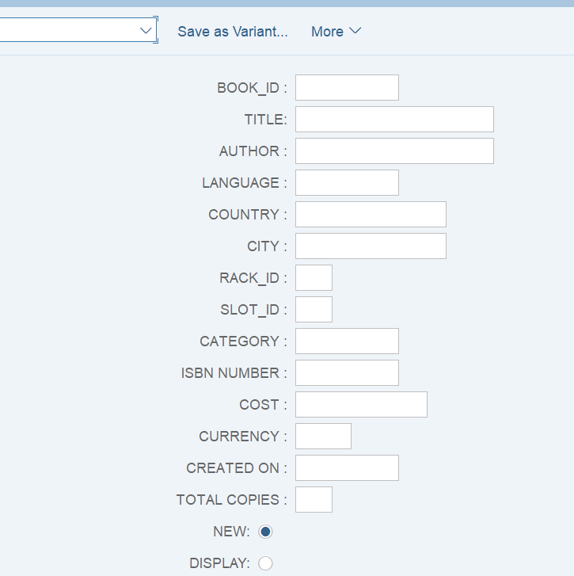
REPORT FOR ZBOOK_MASTER
1️⃣ Enter Book Details
BOOKS PRESENT IN LIBRARY :
Book ID
Title
Author
Language
Country and City
Rack ID and Slot ID
Category
ISBN Number
Cost and Currency
Total Copies
2️⃣ Data Validation
All mandatory fields are filled
The system validates the entered data to ensure:
• Book ID is unique
• Correct data format for ISBN, currency, and date
3️⃣ Store Data
After validation, the system stores the book details in the Book Master database table.
Data is saved in ZBOOK_MASTER table
Acts as the central repository for book information
Used by other programs like book issue and return
Process Flow
Enter Book Details → Data Validation → Store Data 📚

Slide 8
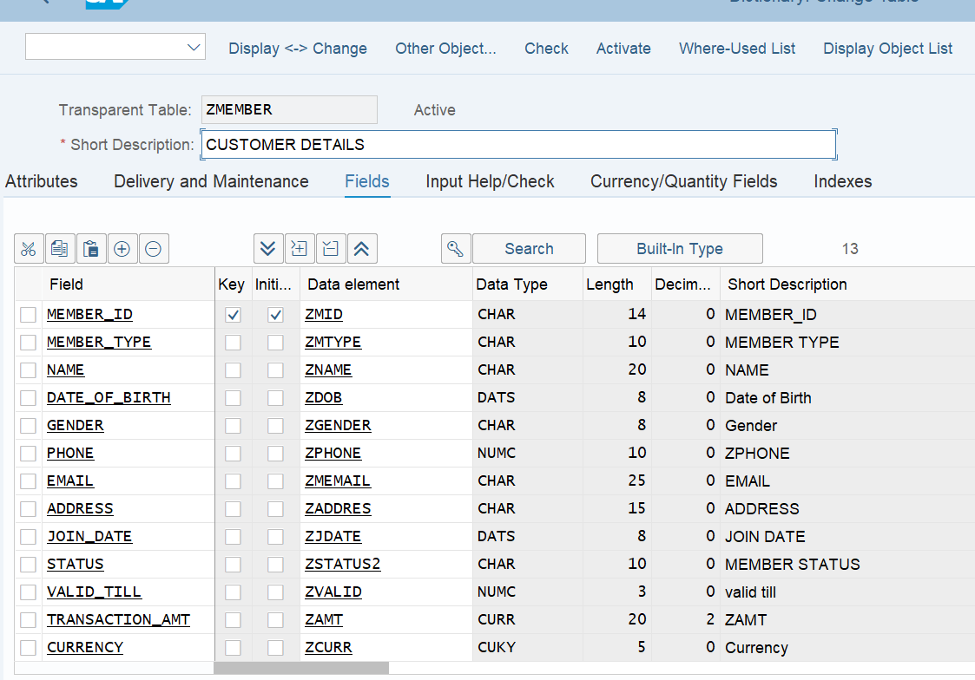
ZMEMBER -- MEMBER DETAILS
Stores complete information of
all library members :
✅ Maintains unique Member ID for each member
✅ Contains details like member name,
gender, and date of birth
✅ Stores contact information such as
phone number, email, and address
✅ Tracks membership type and joining date
✅ Maintains member status (Active / Inactive)
✅ Records membership validity period
✅ Includes transaction amount and currency details 💳📚

Slide 9
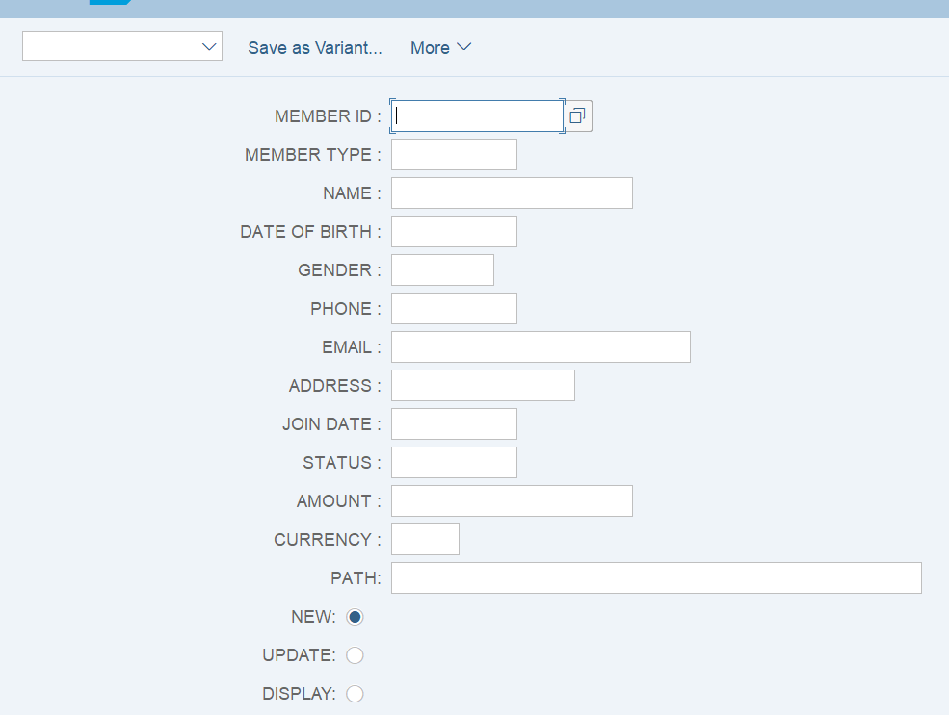
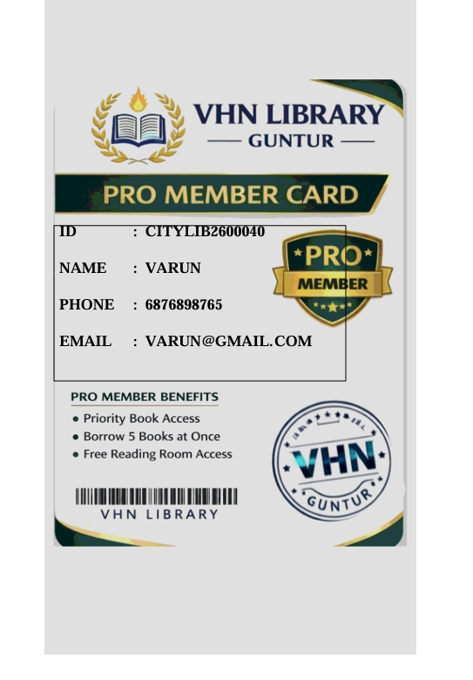
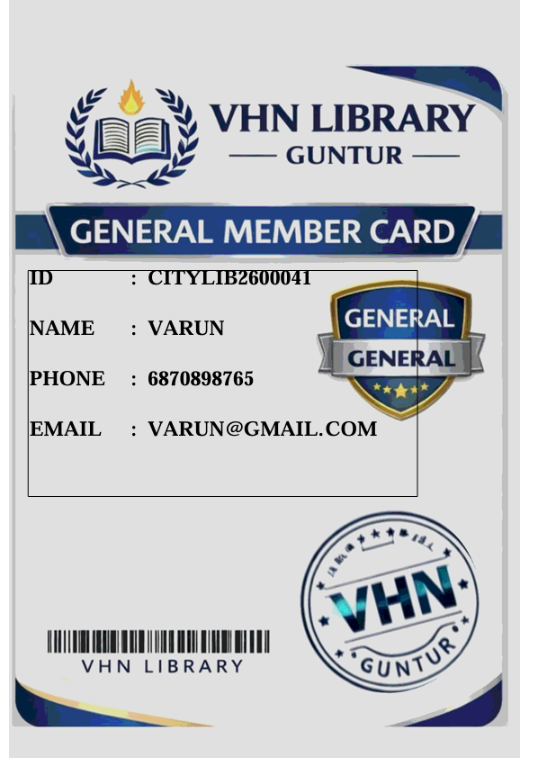
Input screen for zmember table :
It will generates the ID cards for both pro and
General members by using SMARTFORMS.

Slide 10
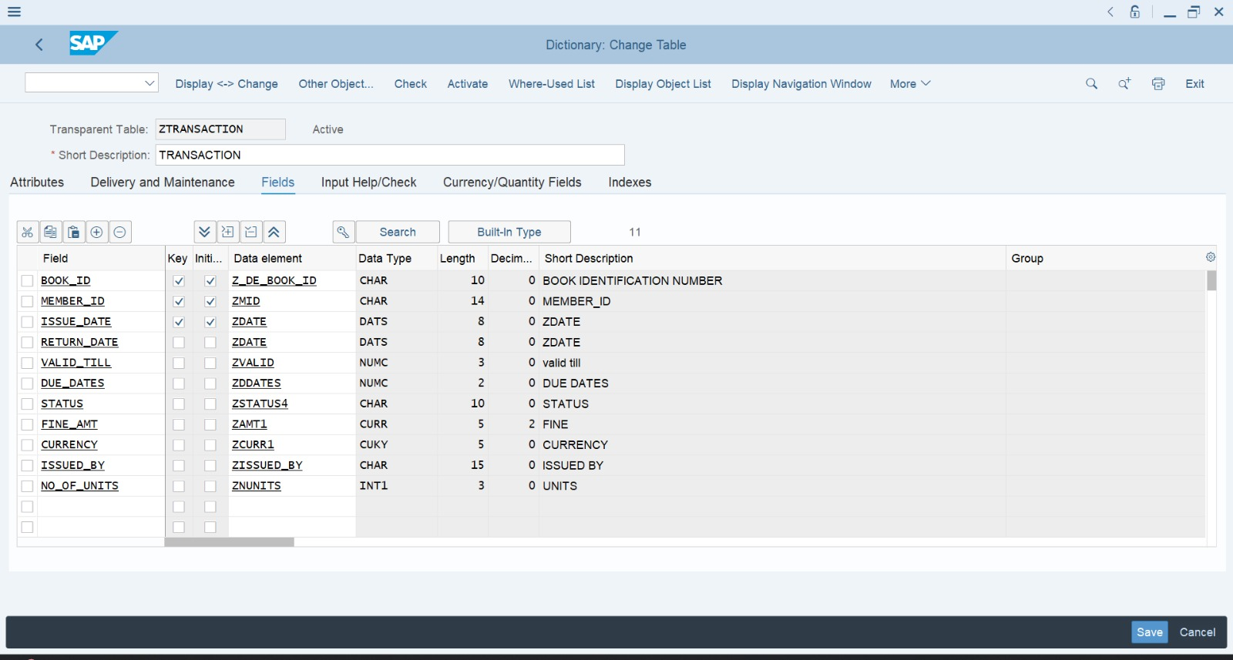
ZTRANSACTION -- TRANSACTIONS
✅ This is a custom transparent
table ZTRANSACTION in SAP
ABAP Data Dictionary (SE11).
✅ It is used to store library book
issue and return transaction details.
✅ Primary key fields are BOOK_ID
, MEMBER_ID, and ISSUE_DATE.
✅ It includes fields for dates, status
, issued-by, and number of units.
✅ It tracks fine amount and currency
for late returns.

Slide 11
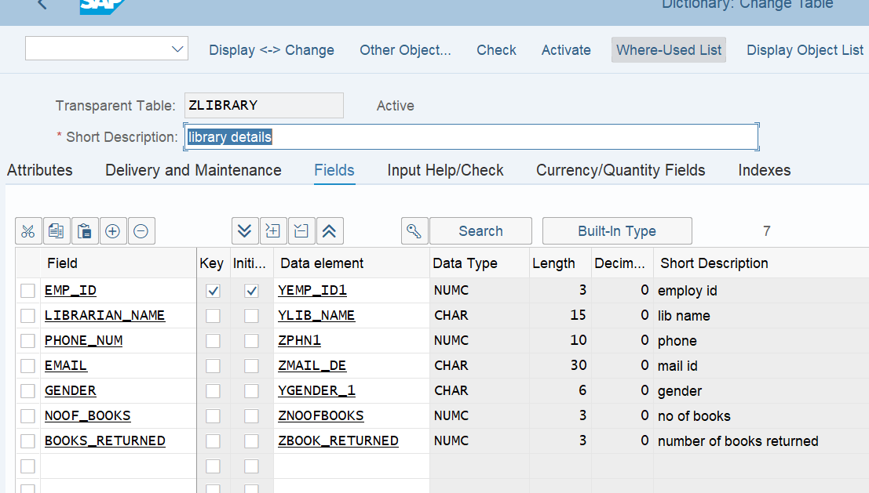
ZLIBRARY -- LIBRARIAN DETAILS
Stores information about library staff (librarians)
✅ Maintains unique Employee ID for
each librarian
✅ Contains details like librarian name
and contact number
✅ Stores email and gender information
✅ Tracks number of books handled by
each librarian
✅ Maintains count of books returned
✅ Helps in monitoring librarian activities and responsibilities 📚

Slide 12
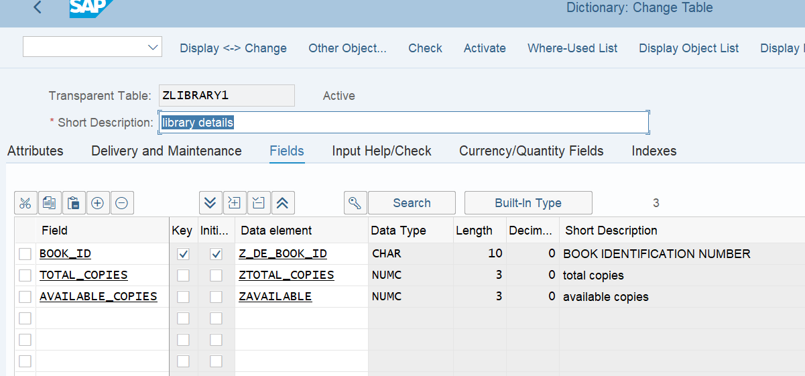
ZLIBRARY1 -- COPIES
Maintains unique Book ID for each book.
✅ Stores total number of copies available in
the library
✅ Tracks available copies for issuing
to students/users
✅ Updates available copies when a book
is issued or returned
✅ Acts as the main reference table for library
book availability

Slide 13
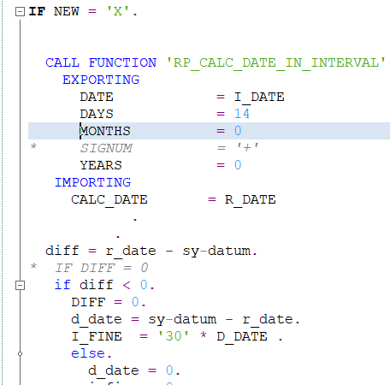
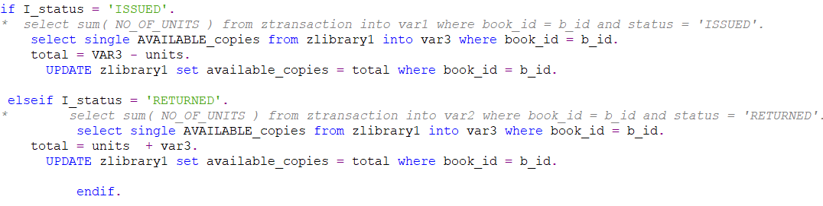
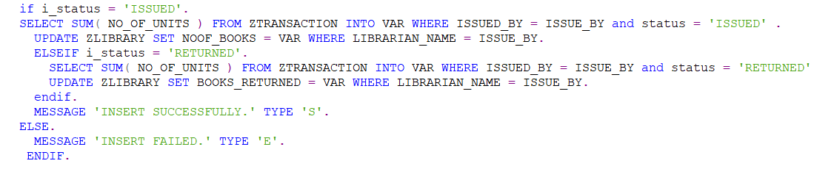
Report for ztransaction – zcode_v1

Slide 14
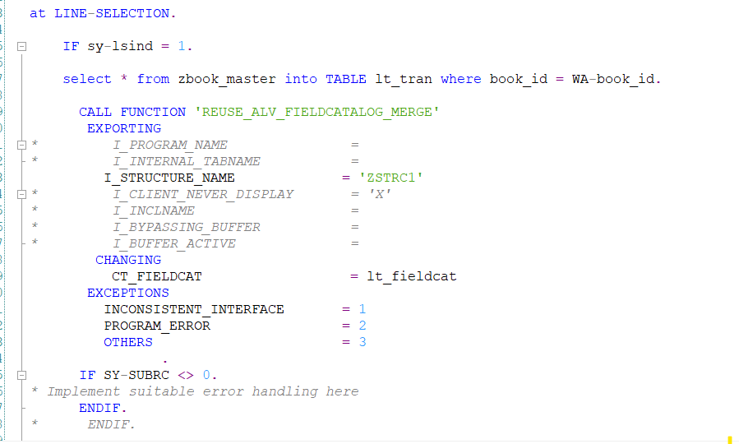
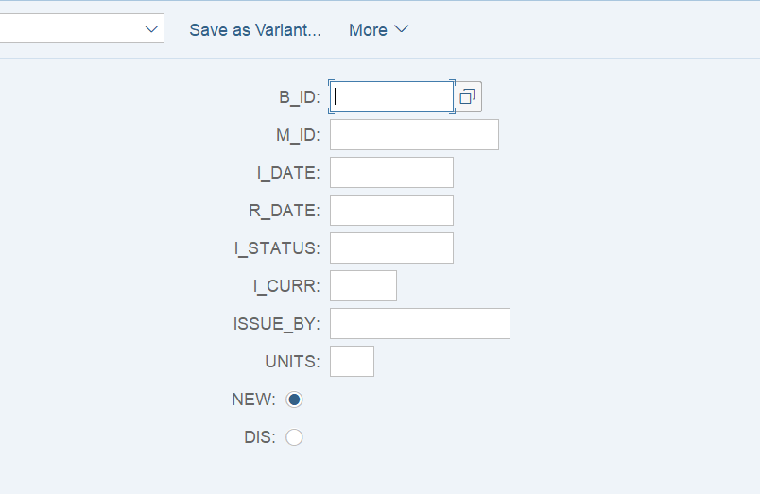
Issue Date – Return Date.
Copies Available.
No Of Books Issued By Librarian.
Interactive Report.
ALV for Interactive Report.

Slide 15
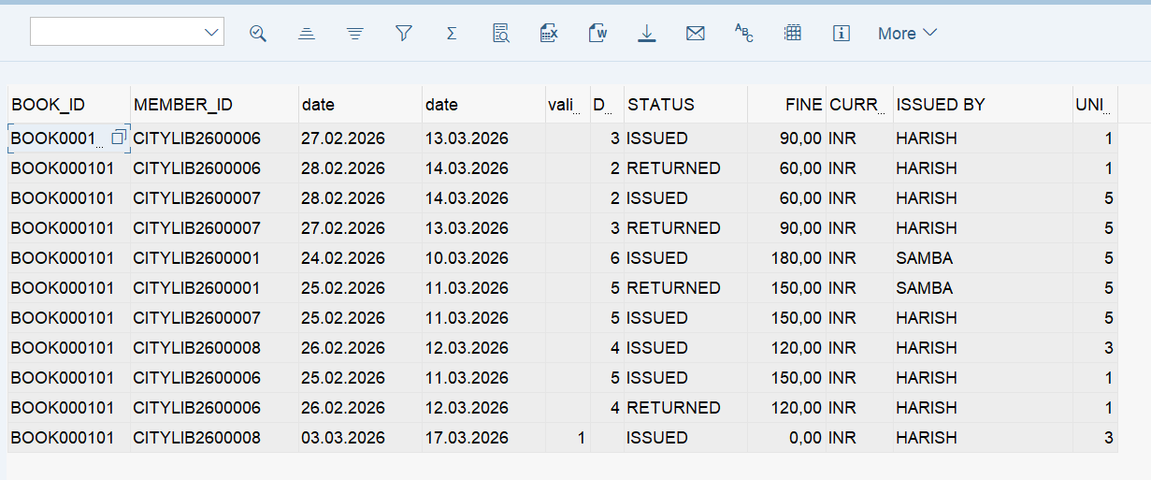
IT displays the transactions present for particular book_id and also overall
data present in library.

Slide 16
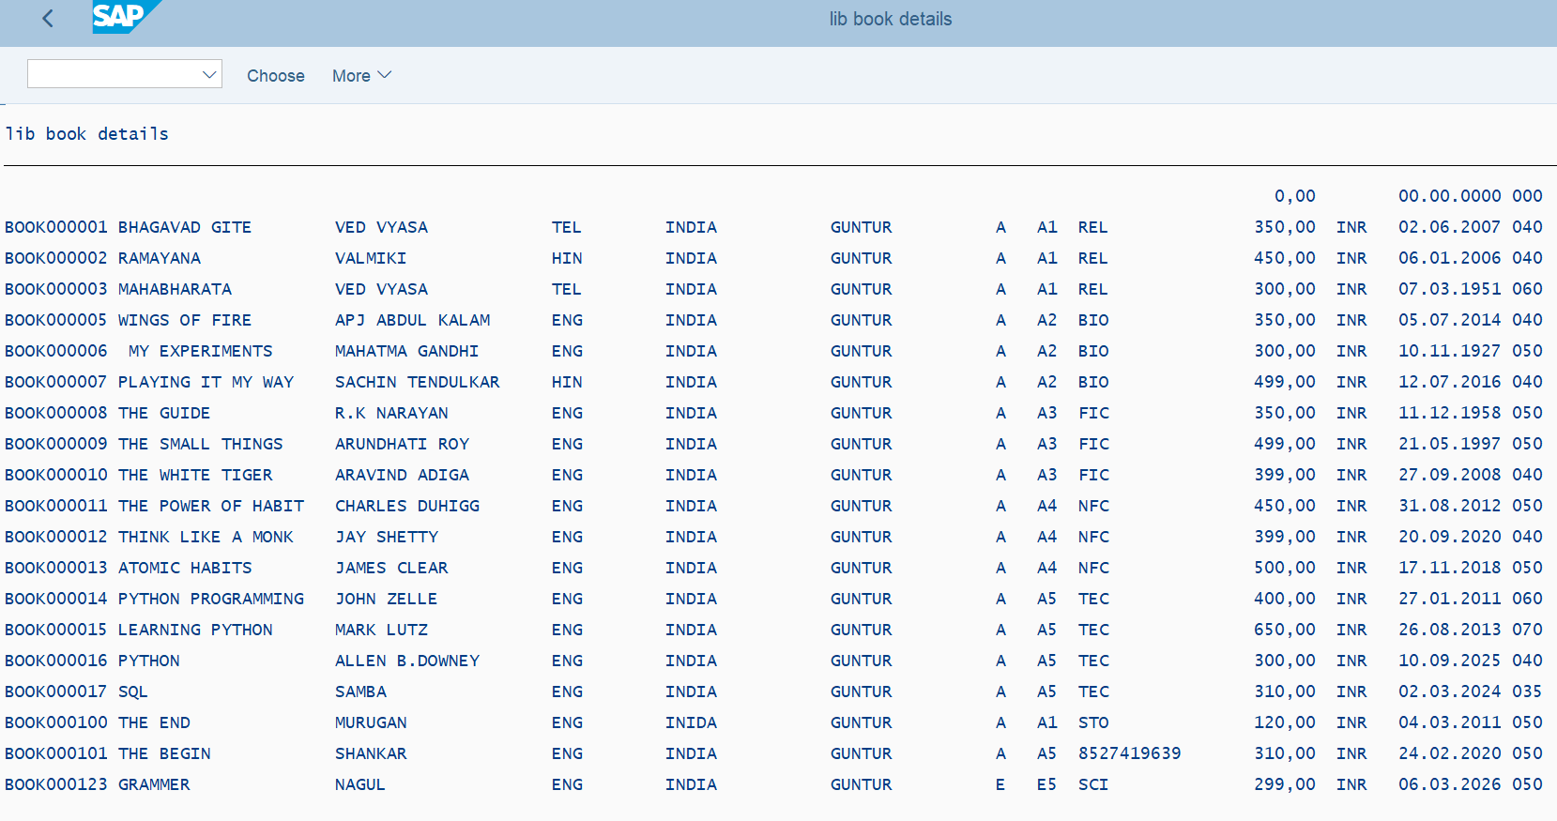
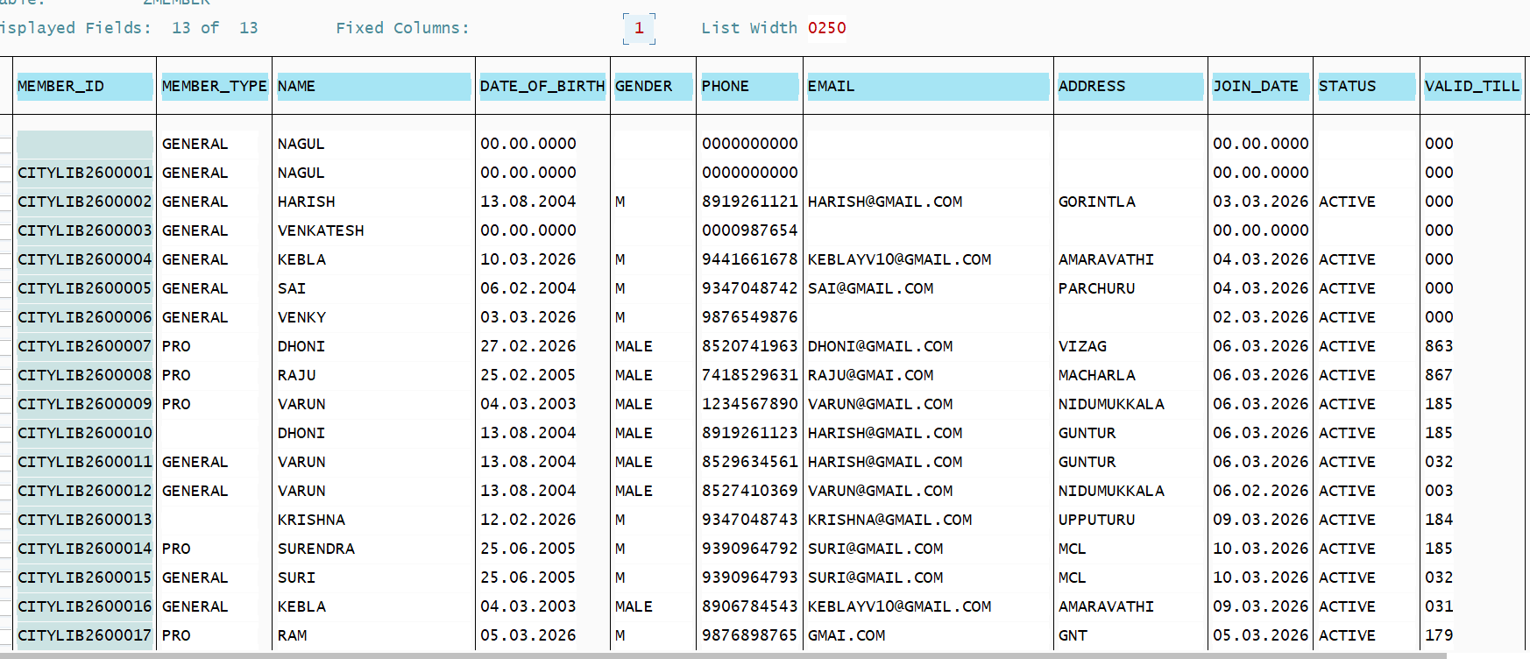
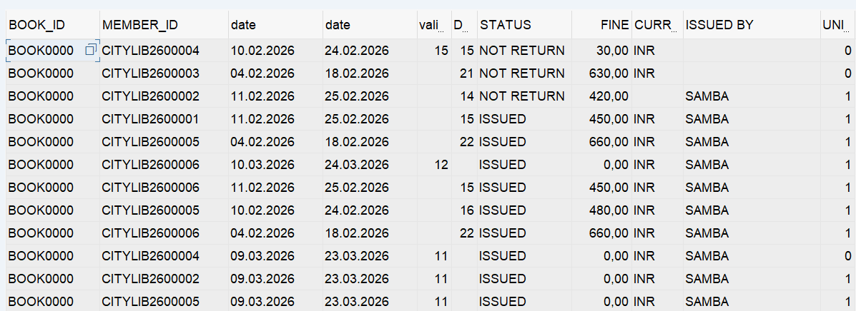
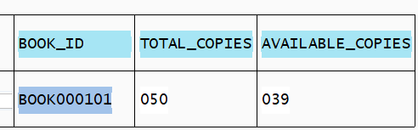
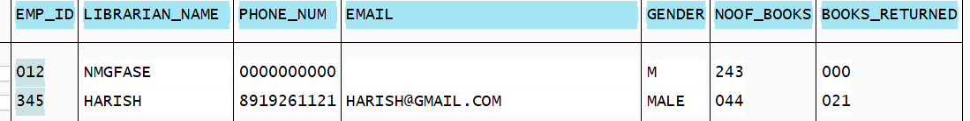
→
↓
←
↓

Slide 17
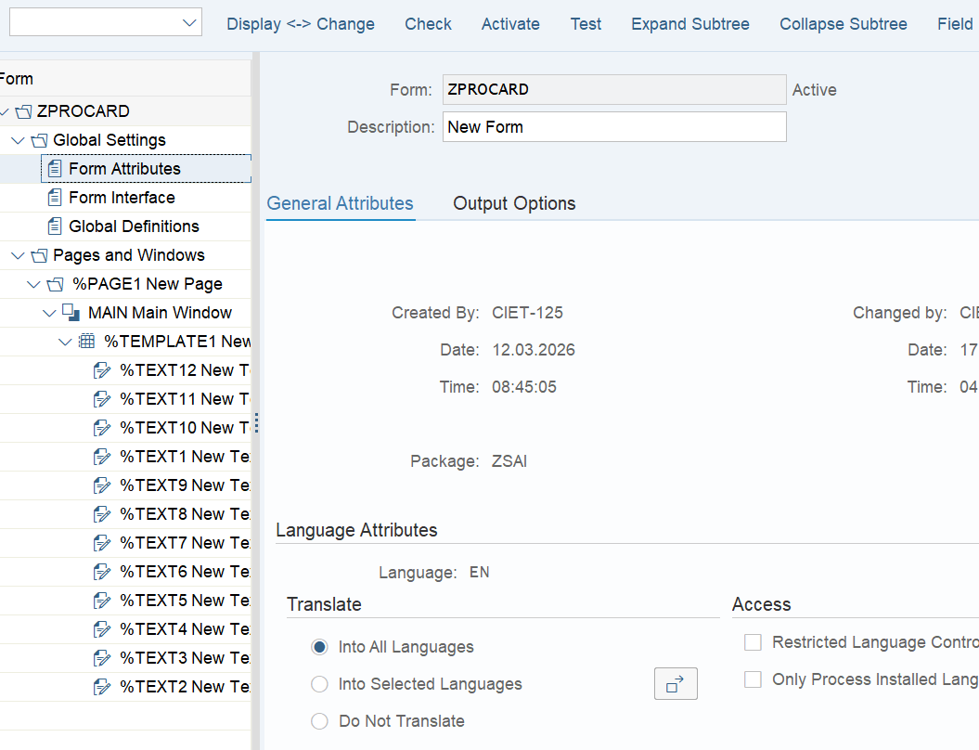
SMART FORM FOR PRO_ID CARD :
→

Slide 18
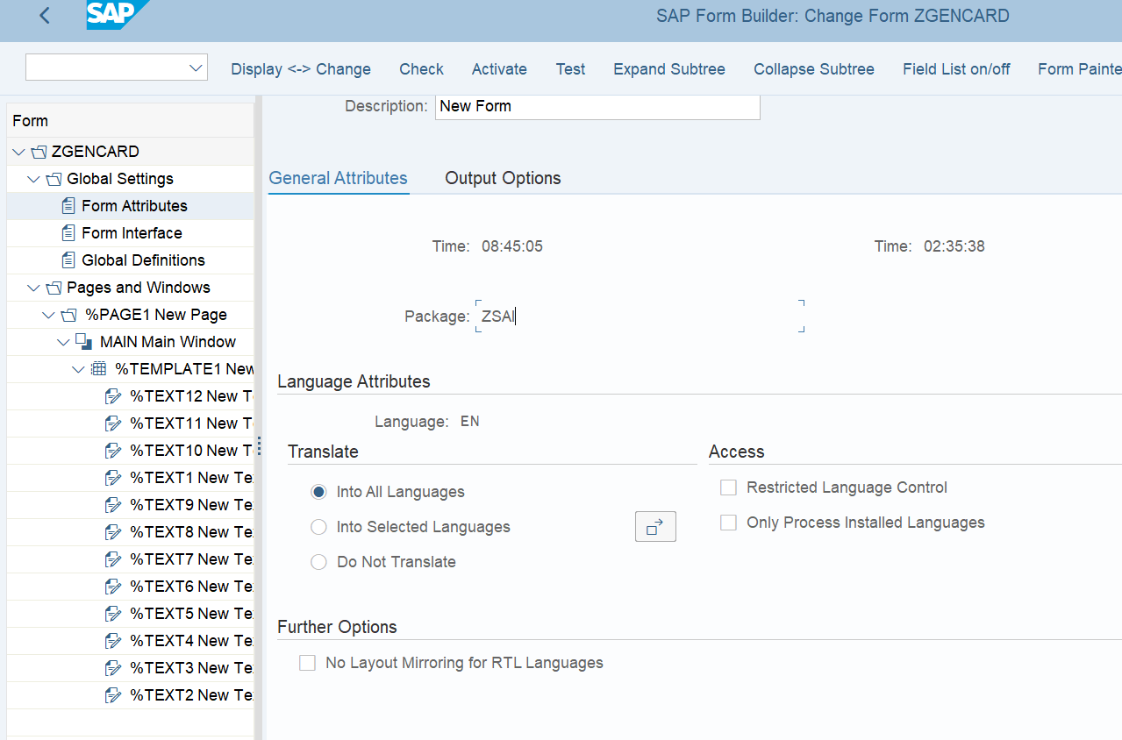
SMART FORM FOR GENERAL_ID CARD :
→

Slide 19
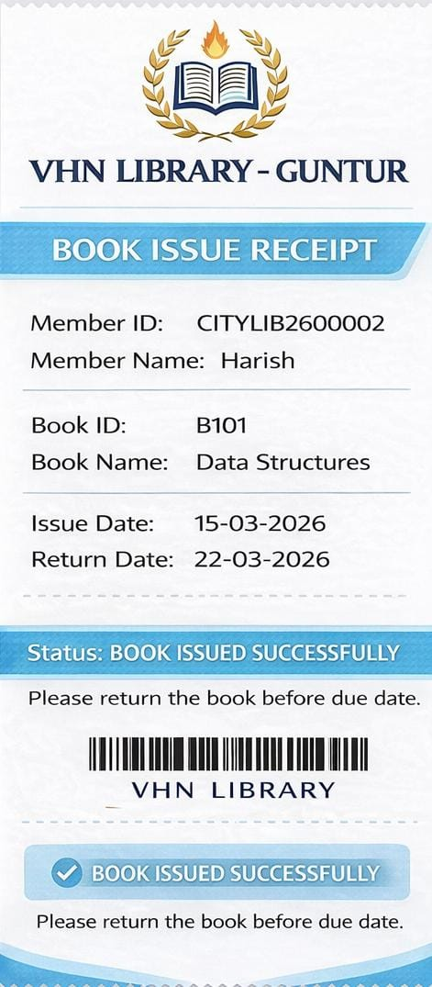
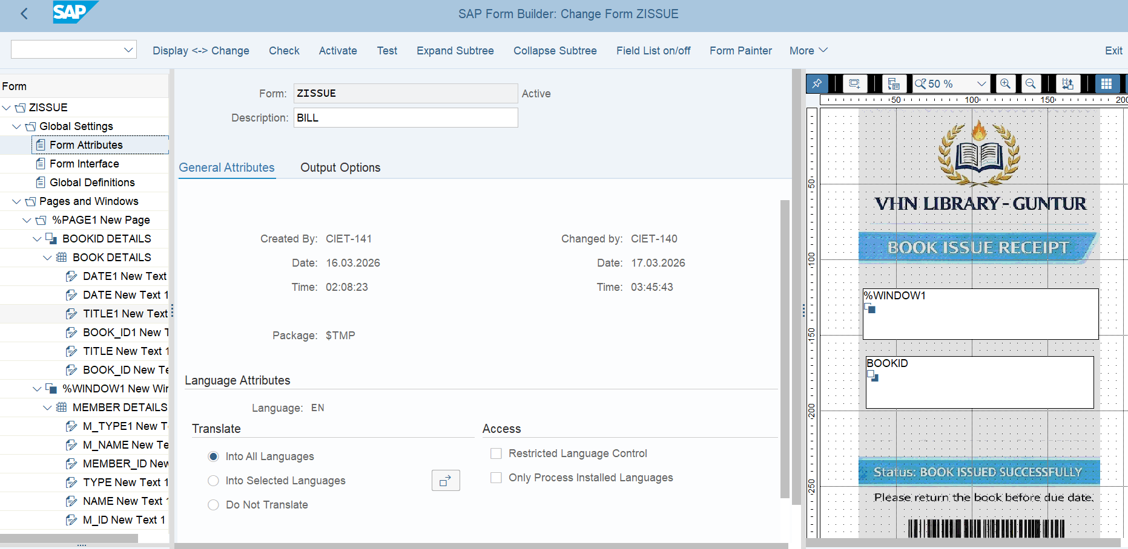
SMART FORM FOR ISSUE RECIPT :
→

Slide 20
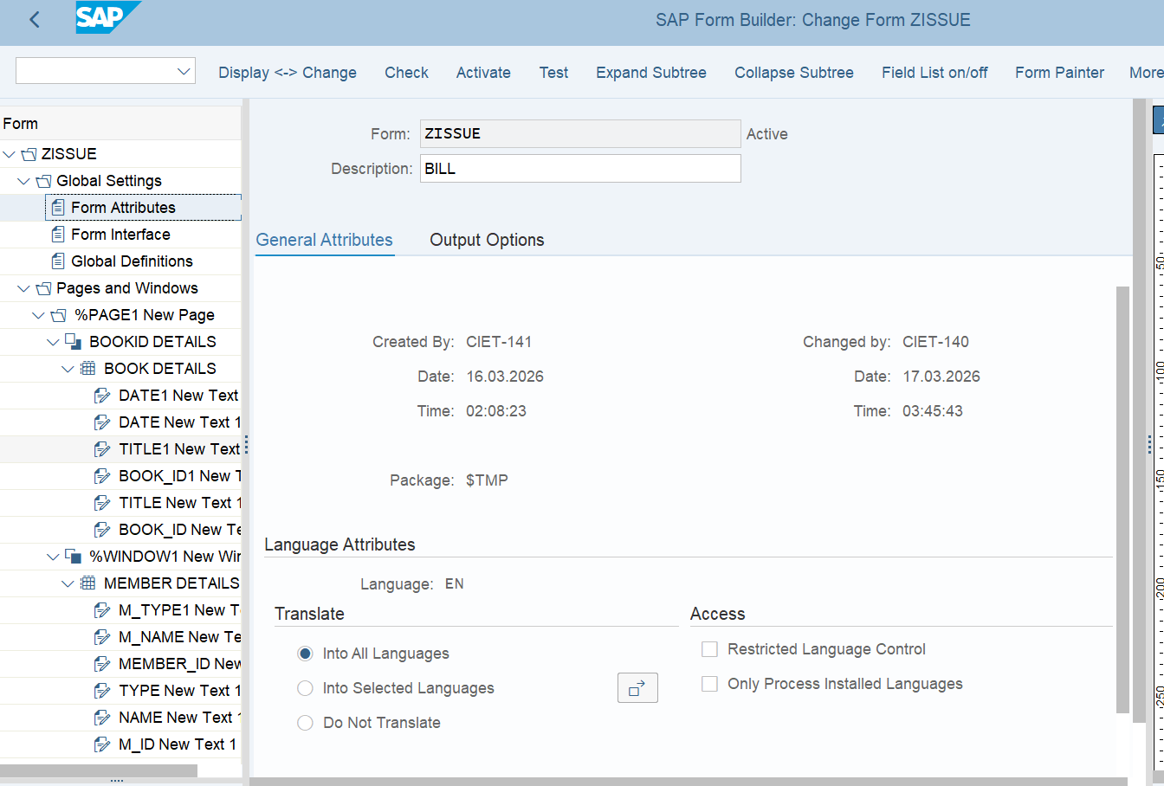
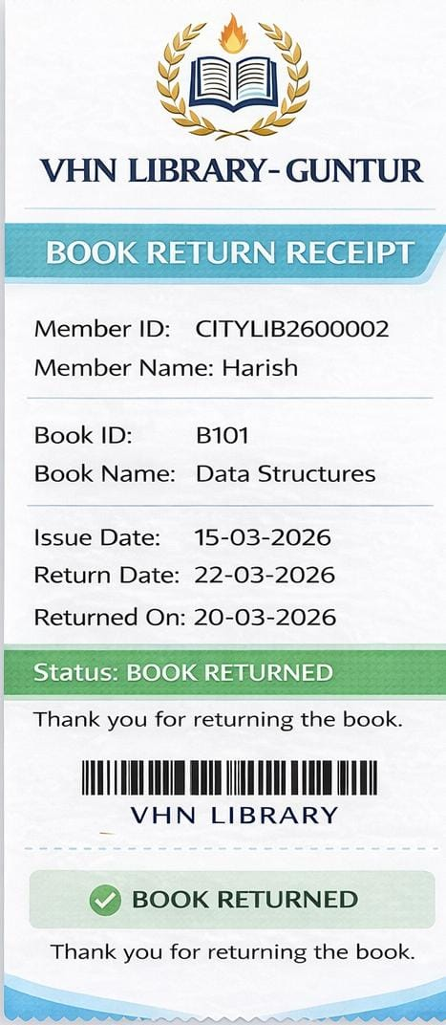
SMART FORM FOR RETURN RECIPT :
→

Slide 21
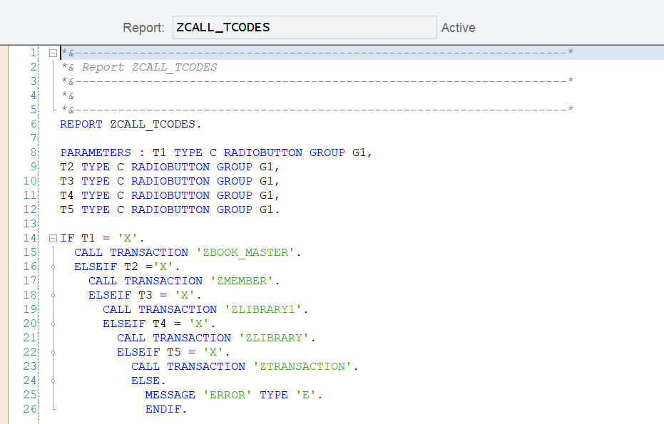
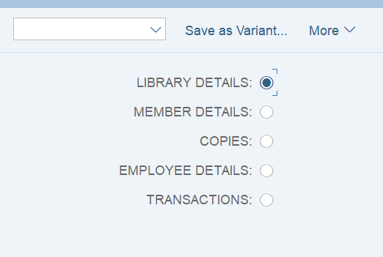
FINAL REPORT FOR ALL REPORTS AND TABLES
INPUT SCREEN FOR FINAL REPORT:

Slide 22
THANK YOU

